Slide 1

Securing the Perimeter
[Your Name]
[Date]

Slide 2
How to Use this Template
We have provided these slides as a guide to ensure you submit all the required components to complete your project successfully.
When presenting your project, remember that these slides are merely a guide. We strongly encourage you to embrace your creative freedom and make changes that reflect your unique vision as long as the required information is present.
You can add slides to the template when your answers or screenshots do not fit on the previously provided pages.
Delete this and all other project instruction slides before submitting your project.
Remember to add your name and the date to the cover page.

Slide 3
Project Scenario

Slide 4
Overview
XYZ is the premier cryptocurrency exchange. They transact over a billion trades everyday and are considered to be one of the most reliable and secure exchanges in the world. Due to their rapid growth, they've faced challenges in scaling their security posture.
The largest challenge they've faced is with their Perimeter Network Security being secure. The networking team was overburdened with the rapid growth and a majority of the network infrastructure was built insecurely.
Due to a lack of visibility and a lack of proper access control setup on the network, it was inevitable that a breach took place! XYZ was hit with a massive attack in which their network was breached and their internal servers were compromised resulting in over 500 Bitcoin being stolen!
Needing to get the bottom of this breach and resolving their current perimeter issues they've contracted you from SecureCorp, a world renowned cybersecurity consulting firm. Your job is to redesign their network architecture securely and set up a SIEM to monitor against future attacks.

Slide 5
Section 1:
Designing a secure Network Architecture

Slide 6
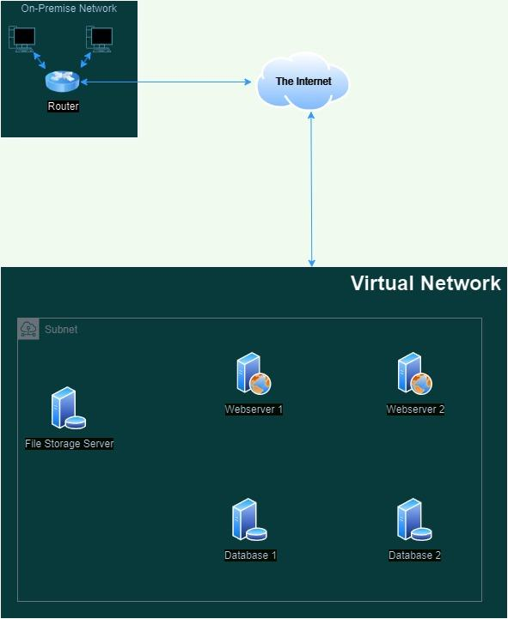
Network Description
Download the drawio.com file from here.
The on-premise network is connected to a virtual network through the internet.
All five servers are located within a single virtual network and in one subnet.
All servers have direct connections to the internet.
The two web servers are required to communicate with the two database servers to function correctly.
The file storage server only needs to be accessible from the on-premise network.

Slide 7
Identify Network Vulnerabilities
In your initial assessment of the company's network, it's essential to pinpoint specific vulnerabilities that could be exploited by malicious actors. Identifying these weaknesses is the first step in reinforcing the network's defenses.
Review the provided network diagram
Identify three major security problems with the current network setup
Describe each identified problem and explain how it poses a risk to the network

Slide 8
Identify Network Vulnerabilities
1. [Security problem]
[Describe each identified problem and explain how it poses a risk to the network]
2. [Security problem]
[Describe each identified problem and explain how it poses a risk to the network]
3. [Security problem]
[Describe each identified problem and explain how it poses a risk to the network]

Slide 9
Network Redesign
With the vulnerabilities identified, it’s time to rearchitect the network. A well-structured network with proper security controls is vital for defending the company's digital assets.
Use drawio.com to create the updated diagram. You can download the original diagram from here.
Update the network diagram to include:
Network segmentation separating public-facing services from internal services.
Placement of firewalls to control and filter traffic
A secure, encrypted connection method for the on-premise network to access the file storage server.
Ensure the updated diagram reflects these additions clearly.

Slide 10
Network Redesign
Place the updated network diagram here.

Slide 11
Convince the Stakeholders
With a proposed network redesign, stakeholders will require a clear understanding of the benefits and necessity of these changes. Your next task is to prepare answers to the following potential questions they may have. In all your answers, make sure to emphasize the security aspects.
Why do we need to add firewalls to our network?
What is the benefit of having different areas in our network for web servers and database servers?
What does a VPN do for our connection to the file storage server?

Slide 12
Identify Network Vulnerabilities
Why do we need to add firewalls to our network?
[Write your answer here]
What is the benefit of having different areas in our network for web servers and database servers?
[Write your answer here]
What does a VPN do for our connection to the file storage server?
[Write your answer here]

Slide 13
Section 2:
Building a secure Network Architecture in VirtualBox

Slide 14
Network Setup
Following the favorable reception of your network diagram, management is keen to see this blueprint come to life in a test environment. They have chosen VirtualBox as the platform to host this venture into the cloud. Your next task is to build the test network, which is detailed below.
Construct two VirtualBox virtual networks (VNet):
Name the first VNet DMZ. Within it, create two subnets:
Public-DMZ for future web servers.
Private-DMZ for database servers.
Name the second VNet Internal and create one subnet within it called Internal-Subnet.
Take and submit a screenshot of the DMZ Virtual Network with the two subnets
Take and submit a screenshot of the Internal Virtual Network with the subnet

Slide 15
Network Setup
Screenshot of the DMZ Virtual Network with the two subnets
[Add Screenshot here]

Slide 16
Network Setup
Screenshot of the Internal Virtual Network with the subnet
[Add Screenshot here]

Slide 17
Section 3:
Continuous Monitoring with a SIEM

Slide 18
Understanding SIEM Benefits
As cyber threats evolve, staying ahead with proactive monitoring is crucial. It's time to get everyone on board with adding a SIEM system to the network. Your task is simple but crucial: convince the stakeholders by pinpointing three major benefits of implementing a SIEM.
Identify at least 3 distinct benefits of implementing a SIEM in an enterprise environment
Write a short description of each benefit

Slide 19
Understanding SIEM Benefits
1. [SIEM Benefit]
[Write a short description detailing its significance]
2. [SIEM Benefit]
[Write a short description detailing its significance]
3. [SIEM Benefit]
[Write a short description detailing its significance]

Slide 20
Deploy SIEM Components in VirtualBox
To give management a tangible understanding of how a Security Information and Event Management (SIEM) system operates, we're going to set up a demonstration in our VirtualBox test environment. This setup will involve deploying a virtual machine for the ELK server within the private subnet and a virtual machine for Filebeat within the public subnet. These components will work in tandem to illustrate the power of centralized logging and real-time analysis.
Deploy a virtual machine named Elk-Server in the Private-DMZ subnet of the DMZ VNet for the ELK stack.
Deploy a virtual machine named Filebeat-VM in the Public-DMZ subnet of the DMZ VNet for Filebeat.
Take and submit screenshots of the VM instances confirming their creation and network placement.

Slide 21
Deploy SIEM Components in Azure
Screenshots of the VM instances confirming their creation and network placement.
[Add Screenshot here]

Slide 22
Setup Monitoring
To fully showcase our SIEM's capabilities, we will set up the ELK (Elasticsearch, Logstash, Kibana) server, install Filebeat on our web server, and ensure that web server logs are correctly forwarded and displayed in Kibana. This comprehensive task is pivotal for demonstrating effective real-time monitoring and analysis of web server activity, which is essential for maintaining operational health and security within our infrastructure.
Install and configure the ELK server on a VM within the Private-DMZ subnet.
Install Filebeat on the web server in the Public-DMZ subnet.
Configure Filebeat to forward logs to the ELK server's Elasticsearch.
Generate traffic on the web server to create log data (i.e. access the server).
Verify logs are forwarded to Elasticsearch and visible in Kibana.
Create screenshots to confirm that the services are running:
Filebeat service running on the web server
Make it from the CLI, with the ‘systemctl status filebeat’
Kibana receives logs from the Filebeat host
From Kibana site SIEM/Hosts/Filebeat-VM

Slide 23
Setup Monitoring
Screenshot of the Filebeat service on the web server (command: ‘systemctl status filebeat’)
.
[Add Screenshot here]

Slide 24
Setup Monitoring
Screenshot showing that Kibana receives logs from the Filebeat host (SIEM/Hosts/Filebeat-VM)
[Add Screenshot here]

Slide 25
Section 4:
Zero Trust

Slide 26
Zero Trust Comparison
Following a significant security breach at XYZ, the necessity to reassess and strengthen our network security architecture is paramount. A comparison between the emerging Zero Trust architecture and traditional network security models will highlight the potential enhancements Zero Trust can offer. Your task involves selecting three key principles from Zero Trust architecture, comparing them to traditional models, and evaluating the benefits of Zero Trust. This analysis is crucial for guiding XYZ towards a more resilient cybersecurity framework.
Select three principles of Zero Trust architecture (you can find them in the classroom and in the next page)
Compare each selected principle to its counterpart in traditional network security models, focusing on:
Differences in approach
Potential benefits of Zero Trust over traditional methods

Slide 27
Zero Trust Principles
Select three principles to use in the comparison:
Consideration of all resources: Every device, software, and system is a potential security vector.
Secured communication: Encrypt all data transfers, irrespective of location.
Per-session access: Grant access to resources only for the duration of a session.
Dynamic access policy: Access is based on real-time evaluations of multiple factors.
Continuous monitoring: Real-time assessment of asset integrity and security.
Dynamic authentication: Ongoing verification before allowing access.
Extensive data collection: Gather detailed information for security enhancement.

Slide 28
Zero Trust Comparison
1. [Principle]
Zero Trust Approach: [Write your comparison here] | Traditional Approach: [Write your comparison here]
Benefits of Zero Trust:[Write your comparison here]
2. [Principle]
Zero Trust Approach: [Write your comparison here] | Traditional Approach: [Write your comparison here]
Benefits of Zero Trust:[Write your comparison here]

Slide 29
Zero Trust Comparison
3. [Principle]
Zero Trust Approach: [Write your comparison here] | Traditional Approach: [Write your comparison here]
Benefits of Zero Trust:[Write your comparison here]

Slide 30
The Zero Trust Model
Following your analysis of Zero Trust versus traditional security models, it’s clear that a Zero Trust framework is essential for enhancing XYZ's network security. The challenge now shifts to selecting the most appropriate Zero Trust model for XYZ from three distinct options: Device Agent & Gateway, Enclave Gateway, or Resource Portal. This selection is critical, as it must align with the unique challenges and goals of the company. Your task is to make an informed choice and articulate why this model stands out as the best fit for XYZ, considering their need for a robust response to recent security vulnerabilities.
Choose one Zero Trust model for XYZ from the following options:
Device Agent & Gateway
Enclave Gateway
Resource Portal
Justify why the selected model is the best fit for XYZ’s current network challenges and security objectives.

Slide 31
Zero Trust Model
[Name of the selected Model]
[Write your justification here. How the model addresses XYZ’s specific security challenges? Why it aligns with XYZ’s security objectives and current network situation? ]

